Slide 1
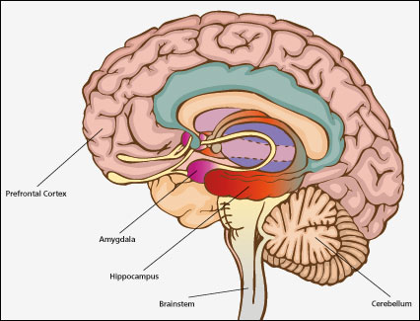
Post-Traumatic Stress (PTS) and Domestic / Sexual Abuse
Normal Response to Abnormal Event
Symptoms include: high stress and emotional arousal, flashbacks, re-experiencing, intrusive thoughts, nightmares, sleep disturbance, hyper-vigilance and avoidance of reminders
Survivors need time to heal naturally immediately after a traumatic event [e.g. 3-4 weeks] and therapy is not helpful initially
Interpersonal events are more likely to result in traumatisation
& can lead to Complex Post-Traumatic Stress Disorder
Survival instincts are stronger & quicker than ‘thinking’ responses
Flop/freeze responses are common but people ‘think’ they would react differently – implications for justice system and self-appraisal
Fragmented memory [inconsistent narrative] is problematic for criminal justice proceedings
3 Brains | Important Neurological Systems in Processing Trauma [a simplified interpretation]
Lower or Reptilian [Body] | Brainstem – physical regulation e.g. heartbeat, breathing, startle response
Middle or Limbic [Emotions] | Amygdala – processes emotion, early memory & attachment, holds emotional memory, attends to threat Hippocampus – stores memory (life events in correct space & time, facts and recognising people) – less accessible when under threat
Higher or Neocortex [Thinking] | Pre-Frontal Cortex – responsible for making meanings, self-awareness, language, working memory, cognitive flexibility, planning, problem-solving – this part of the brain deactivates under threat
The ‘F’s : survival instincts and responses
• Fight | Resistance or aggression (physical or verbal)
• Flight | Running or backing away
• Freeze | Immobilised, Muscles Tense (sympathetic nervous system)
• Flop | Shutting down, appeasing attacker, submitting (parasympathetic nervous system)
• Friend | Feeling under threat activates our attachment / relational security instincts (problematic in abuse)
• Fragment | Disrupted formation of memory, and Dissociation - zoning out, feeling numb, switching off
Food, Family Fornicate | Other instincts for survival and gene replication
Sources: Zoe Lodrick 2007 / van der Kolk 2002

